Slide 1
Working Through Transitions and Institutional Change
Meg Delaney and Amy Hartman
Toledo Lucas County Public Library
PLA Conference 2020

Slide 2
Got Change?
Notes:
Alternate reading each line:
AH - Welcome! We’re here to talk about Change with a capital C and that rhymes with T and that stands for TOLEDO! Friends, we’ve got a tale of trouble…
MD - On September 1, 2018, TLCPL’s Main Library closed for one year of renovation. Most of Main’s public service staff were spread throughout the system or assigned new temporary positions embedded in the community for the duration
AH - On January 24, 2019, Library Director Clyde Scoles announced his plan for retirement after 34 years in that role, effective by the end of June.
Twenty-two days later on February 15, Clyde Scoles collapsed as he left work for the day and passed away unexpectedly
MD - August 1, Former Deputy, Acting Director Jason Kucsma officially became Director
AH - September 28, newly renovated Main Library opened to the public, with a new service model and 150,000 square feet of public spaces changed
MD - October 18, Director Jason Kucsma asked for feedback on organizational needs and suggestions/ideas for reorganizing the administrative council structure
AH - November 21, the entire administrative organization design is restructured
2019 was…. A Year. With a Capital “Y” …. usually followed by the word ME with ?!?!?!?!?!!???
Introduce ourselves – and the lens through which we build the presentation.
Amy Hartman, Collection Development Specialist, for many years on the leadership team of the Association for Public Library Employees (aka APLE), presenting the staff view of weathering change.

Slide 3
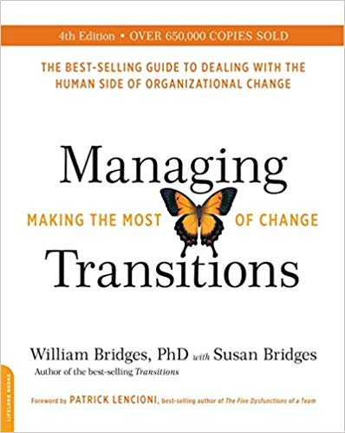
The Book(s)
Managing Transitions: Making the Most of Change by William Bridges with Susan Bridges (4th Edition, 2016)
Fifteen-page summary available on PLA handouts site
Transitions: Making Sense of Life’s Changes by William Bridges with Susan Bridges (40th anniversary ed, 2019)
Notes:
AH
First edition Of Transitions written in 1980, first of Managing Transitions in 1991.
Given a summary by a friend on the Leadership team of the Buddhist Temple of Toledo. You’d think that as Buddhists who spend a great deal of time meditating on the subject of impermanence, we’d be good with transitions. You’d be wrong, wrong, WRONG.
The slides from this presentation and a 15-page “best-of” summary is available on the PLA handouts site. The book is extremely readable, the 15 page summary hits the high points from a library perspective, this presentation will hit maybe ¼ of what’s on the summary.
The Bridges formed a consulting firm to help institutions with complex transitions, so if you’re really struggling, that might be a good investment.

Slide 4
Change vs. Transition
Change is situational: the move to a new site, the retirement of the founder, the reorganization of the administrative team
Transition is a 3-phase process people go through while internalizing and coming to terms with the details of the new situation brought about by change
When change happens without transition, it is just a rearrangement of the chairs. People say,
“Just because everything has changed, doesn’t mean anything is different around here.”
Notes:
AH
Change hinges on the external situation; what one does: the move to a new site, retirement of a founder, or incorporating new technology. It’s situational.
Transition is psychological, based on how one feels, and depends on letting go of the old reality and the old identity we had before the change took place. It’s how we internalize what is happening. Bridges talks about it being a 3-phase process we must progress through while coming to terms with our new situation.
Think of getting your first job, moving into your first home, or even way back when we first got the internet in libraries.
The actual change happens pretty fast, but the psychological transition happened much more slowly: instead of becoming a new person as fast as we changed outwardly, we found ourselves struggling for a time in a state that was neither the old nor the new. It was a kind of emotional wilderness, a time when it wasn’t quite clear who we were at that point, or what was real.
When change happens without transition, it is just a rearrangement of the chairs. People say, “Just because everything has changed, doesn’t mean anything is different.”

Slide 5
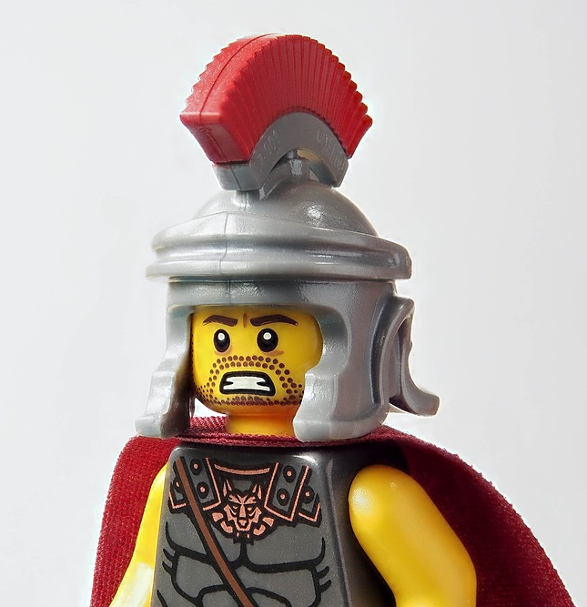
Leading Transition
Even the best leaders cannot anticipate all changes, but all leaders can improve their effectiveness in helping their organization through the transition process
As a leader you cannot always tell your team, “We are on top of every change that comes our way,” but you can tell them “We’ve successfully dealt with change before, and if we manage this transition properly, we will come out stronger in the end.”
Notes:
MD
Managing people and organizations during times of tumultuous change is one of the most difficult tasks leaders face. During such times, it’s always tempting to take short cuts, accomplish quick results and move on to the next thing.
But this tends to backfire and the organization either gets bogged down in resistance to change or struggles through poorly planned change and winds up with endless tangential problems, slowing progress, building a culture of distrust and animosity, and making future successful change even more difficult to achieve.
Helping people through this process will ultimately make leading them easier and will build an important level of trust going forward.

Slide 6
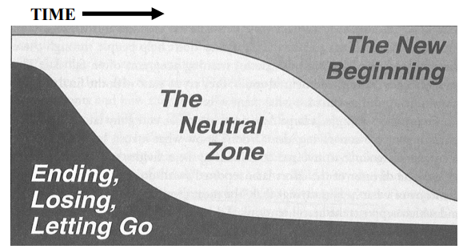
Visualizing Transition
Three Phases of Transition
Ending – letting go of the old ways and old identity
Neutral Zone – the in-between time where the old is gone but the new isn’t fully operational
New Beginning – Coming out of transition and developing the new identity/ways
Notes:
AH
We’re going to discuss each phase, give examples of how we navigated through them, sometimes successfully, sometimes not so much, and share insights learned.

Slide 7
Step 1: Ending
The starting point for managing transition is not the outcome but the ending that must be made to leave the old situation behind
Before beginning something new, people have to let go of the present first
Beginnings depend on endings
The problem is, people don’t like endings
Notes:
MD
[Read the 1st bullet point]
The starting point for managing transition is not the outcome but the ending that you’ll have to make to leave the old situation behind.
First task of change management: understand the desired outcome and how to get there
First task of transition management: convince people to leave home
Organizations that overlook that letting-go process do nothing about the feelings of loss that it generates.
And in overlooking those effects, they nearly guarantee that the transition will be mismanaged and that, as a result, the change will go badly.
Examples of endings:
Changing collection development processes and moving to a Floating Collection
Main closing
Therefore, staff reassignments – but…. That will lead to new opportunities
The point is to be explicit about the ending; you want people to willingly come to the Neutral Zone. From the chaos of Endings comes the creativity of new opportunities.
Creating a wholly new department from people with previous assignments
My first thought was to bring the 2 affected managers together so we could build the process together

Slide 8
How to get people to let go
Effective Change agents:
Accept the reality and importance of subjective losses
Expect some period of overreaction and traditional signs of grieving
Acknowledge losses openly and sympathetically
Give people information, frequently and in as many ways as possible
Define what is over and what isn’t
Notes:
AH Librarians are a passionate people, and most of us love what we do. Good results depend on getting people to stop doing things the old way and start doing things a new way. And since library staff have this intensely personal connection to how they work, there is just no way to do that impersonally. It is self-defeating to try to overcome people’s resistance to change without addressing the threat the change poses to their world.
Accept the Reality and Importance of the Subjective Losses: Basically: Allow people to feel what they are feeling, which requires leaders to
Expect some period of overreaction : Bridges talks about our perception of “overreaction” as basically any level of reaction that is higher or more intense than out own. It’s when they are reacting to change more than we are:
Changes cause transitions, which cause losses, and it is often the loss, not the change, that they’re overacting to.
It’s usually a piece of employees’ world that is being lost, not a piece of management’s, and everyone reacts that way when it’s part of their world that is being lost. Being reasonable is much easier if you have little or nothing at stake.
Overreacting also comes from past experiences, either with losses that haven’t adequately been dealt with or when endings became viewed as symbolic of some larger loss. Learn to look for the loss behind the “overreaction” and deal with the underlying issue. Think about the internet. The panic came from losing our sense of expertise, of technology taking away the foundation of what we did.
AH Expect and Accept the Signs of Grieving: When endings take place, people get angry, sad, frightened, depressed, and confused. These emotional states can be mistaken for bad morale, but they aren’t. They’re signs of grieving, the natural sequence of emotions people go through when they lose something that matters to them. Always expect to see various displays of • Denial • Anger • Bargaining • Anxiety • Sadness • Disorientation • Depression.
AH Acknowledge the Losses Openly and Sympathetically: Don’t shy away from bringing losses out into the open—acknowledge them, express your concern for the affected people and your intention to help them find the best way forward. Do it simply and directly. It is pretending that the loss is inconsequential or doesn’t even exist that stirs up trouble, not the acknowledgement/discussion of it. Research on what helps people recover from loss of all kinds agrees that recovery happens more quickly if the losses can be openly discussed.
MD Give people information: Threatening information is absorbed remarkably slowly, and often incompletely. Leaders must find as many different ways to share as possible. When people don’t understand what is going on, resentment and fear blossom. People will create stories of their own to explain what is happening, usually relying on innuendo, gossip, wild guesses and worst-case-scenarios (in the absence of facts – people make them up!) Say what you know, admit you don’t know more and provide a timetable for additional information, repeat the cycle often and regularly.
For example: related to revising the floor plan for each department, we started with a current plan – and made a list of everything we wanted to add or change. Then, I made those changes by putting post its on the floor plan. That diagram went to the architects, and then each draft from the architects went back to department meetings. In this way staff could see their ideas reflected on the evolving plan.
Later, when we discovered we were going to close Main, there were dozens, if not hundreds of questions. We compiled that information into a table that described the plan to accommodate programs, services, and customers.
** You don’t have to have it all figured out before you start talking about the changes that are coming.
MD Define what’s over and what isn’t: One of the most important leadership roles during times of change is that of putting into words what it is time to leave behind.
Leaders risk three equally serious and difficult reactions when they do not specify what is over and what isn’t:
1. People don’t dare to stop doing anything; they try to do all the old things and the new things. Soon they burn out with the overload.
2. People make their own decisions about what to discard and what to keep, and the result is inconsistency and chaos.
3. People toss out everything that was done in the past, and the baby, the tub and all the toys disappear with the bathwater.
Back to that example of creating a new department – Fact and Fiction:
We held joint meetings with all the affected staff, shared what we knew, and answered their questions
We provided ways for them to ask questions from a more private setting, and shared the answers in a growing FAQ list
Meetings continued during Main’s temporary closure so that staff could successfully have Endings, navigate the Neutral Zone, and move on to the Beginnings of the programs and services they would offer as Main reopened

Slide 9
Step 2: The Neutral Zone
Psychological no-man’s–land between letting go of the old reality and landing into the new one; both a dangerous and an opportune place
Capitalize on all the confusion by encouraging everyone to be creative; with everything up in the air anyway, people are more willing than usual to try new things
Use a Test & Try methodology
Notes:
MD
Many may mistakenly conclude that the confusion and feelings of groundlessness in this phase are a sign that something is wrong.
Some may be alarmed in this no-man’s-land and try to prematurely escape. (Employees do this frequently, which is why there is often an increased level of turnover during organizational changes.)
Painful though it is, the neutral zone is the individual’s and the organization’s best chance to be creative, to develop into what they need to become, and to rejuvenate themselves for the time ahead. The task before a leader becomes twofold: first, to get your people through the neutral zone in one piece; and second, to capitalize on all the confusion by encouraging them to be innovative.
Encourage experimentation and a Test and Try atmosphere, brainstorm and try new answers to old problems
Embrace losses, setbacks, or disadvantages as learning opportunities and entry points into new solutions
Examples:
During Main’s temporary closure we encouraged the staff and teams that were working “differently” to really dig in and try some new things.
Tech Team surveyed staff to understand where people needed help, then worked with managers to schedule 1:1 coaching and small classes. The success of those efforts built positive momentum for the possibilities of working differently.
Also, as soon as Main’s closing was announced, individuals and social service agencies asked about the impact on those experiencing homelessness
County Commissioners, Library, and about 8 other groups met bi-monthly, to have a solution in place for winter
Collaborative approach to the Life Revitalization Center
Other groups working on Rapid Rehousing and Housing First models
That satellite library is a success and continues to this day

Slide 10
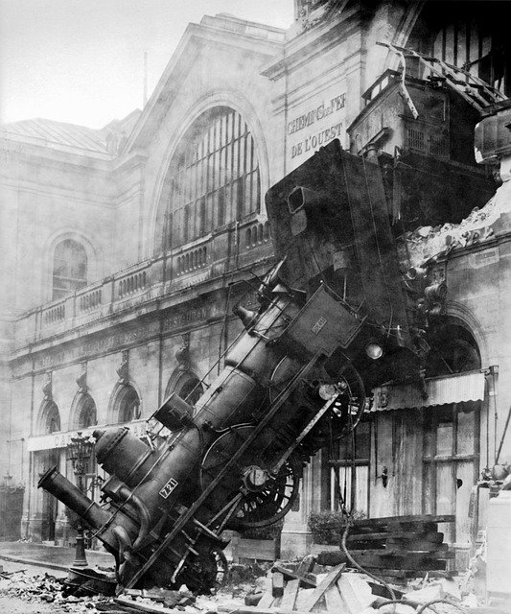
Different timelines = Easy Derailment
Leaders go through their transitions before they launch the changes and now they’re ready for a new beginning.
Employees will be entering the transition cycle when the change is announced.
Change leaders will be significantly ahead of those being led, in processing the new idea. How can understanding this help with leading transition more effectively?
Notes:
AH – Biggest “aha!” moment in the entire book:
Leaders typically go through their transitions before they launch the changes. By the time they are ready to announce the change, they have left their endings and neutral zones behind, and now they’re ready for a new beginning.
But staff and employees will just be entering the ending phase at the point the change is announced.
Change leaders will be significantly ahead of those being lead, in processing the new idea. Understanding this will help with leading transition more effectively.
As a union leader, I got to simultaneously appreciate both perspectives where staff were in the “overreact” zone and leaders were in the perceiving bad morale and obstinance realm.
Perfect example of this was the way we announced Main’s closure:
- This was such a big decision, management didn’t want “leaks” to happen before they could officially announce the closure.
Email to +All at the same time that the local paper ran the story. Staff freaked out. They didn’t have a chance to process before being the public face of this change. Staff were grieving and “overreacting” at the same time we had to field questions from the public about the decision we’d just learned about ourselves.

Slide 11
Strengthen Intra-Group Connections
Allowing Everyone to Play a Part:
Gives people new insight into the real problems being faced by the organization
Gets people aligned as they focus together on solving problems, creating allies rather than adversaries
Brings participants’ firsthand knowledge to bear on solving the problems. Leaders can’t anticipate everything. Front line input can be extremely helpful
Everyone who plays a part is, tacitly at least, implicated in the outcome
Notes:
MD – Getting people through the neutral zone:
Strengthen intra-group connections: The neutral zone is a lonely place. People feel isolated, especially if they don’t understand what is happening to them. Old problems are likely to resurface, and old resentments are likely to come back to life. It is especially important to try to rebuild a sense of identification with the group and of connectedness with one another via good communication. Be wary of any arrangement or activity that shows a preference for one group over others. During this middle phase of transition, people want to feel that ‘we are all in this boat together
Employees need to see the role and their relationship to others in the new scheme of things. Until they know this, they can’t begin to adjust hopes and fears to meet their new reality. They need a role in dealing effectively with the transition process itself.
Leaders should ask: How can I make this interim between the old and the new not only a bearable time but a time during which the organization and everyone’s place in it are enhanced? How can we come out of this waiting time better than we were before the transition started?
Staff forums
Meetings during Main closure
Example of AV/Computers and Media during the temporary closure & that leadership model might not have been the best choice.
Going forward, how does that team further come together

Slide 12
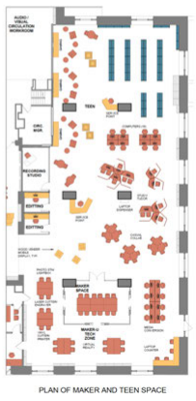
Help People Visualize
Paint a picture of how the outcome will look/feel: Purposes are critical to beginnings, but can be abstract. Give a picture of how the outcome will look
Use visuals (floor plans, flow charts, etc.) to convey how things will be. Listen to input on design and incorporate where possible.
If possible, arrange for people to see another organization where things are already done in the new way. Anything you can do to help people visualize the change will help.
Notes:
MD
Picture: Be careful not to overwhelm people with a picture that is so far ahead of where they are or hard for them to identify with that they become intimidated rather than excited.
Examples:
How will the beginning work? Seeing it (visuals) makes it more successful
Why did we need the renovation in the first place? Why did Main need to close?
Tours to potential sponsors/donors: alignment & working forward
Internal and External – Arts Comm & Making equipment

Slide 13
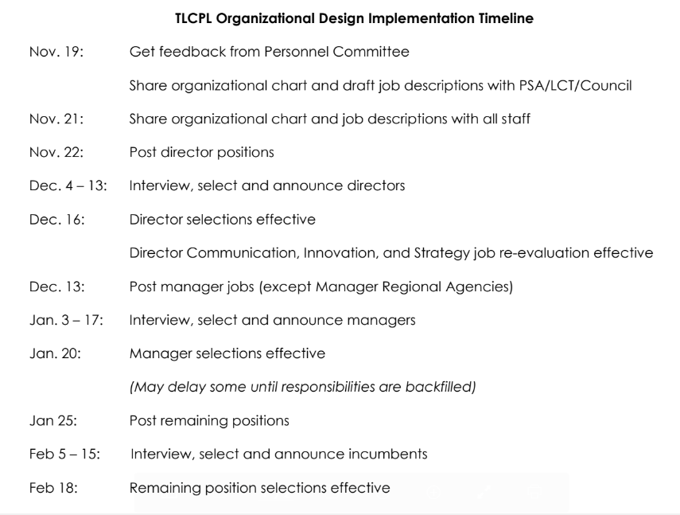
Share a Plan
Plans are immensely reassuring to people, not just because they contain information, but because they exist.
Lay out a step-by-step plan for phasing in the outcome
Outline the steps and schedule by which people will receive the information, training and support needed to make the transition
Notes:
AH
Plans are immensely reassuring to people, not just because they contain information, but because they exist.
Give people information: Say what you know, admit you don’t know more and provide a timetable for additional information, repeat the cycle often and regularly. It helps to have access to living documents of what leaders are working on. We need to know what you don’t know, otherwise we assume you’re keeping things from us either because you’re afraid to admit what you’ve decided, you don’t understand what we need to know, or you just don’t care. In an information vacuum, which voice is going to dominate? The one who says, “We can DO this, everyone! It’s going to be GREAT!”? Or the one who says “WE’RE GOING TO DIIIIIIEEEEEEEE! Children and highly literate people to the lifeboats! Run away!”?
Plans also help those who are operationally or functional minded, the picture can be interesting, but they get frustrated by lack of details. For them, the question is, “What do we do on Monday?” A transition plan outlines the steps and schedule by which people will receive the information, training and support needed to make the transition. It lays out the nature and timing of key events.
In communications along the way, effective leaders speak to wherever people are NOW, not just to where they’ll be “someday”. At this point, employees need help, not in achieving the destination they’ll ultimately reach, but in taking the NEXT BEST STEP in the transition process. What kind of reinforcements will help people develop the new attitudes and behaviors that will be necessary if the new beginning is to work? Point of a plan isn’t to share every bit of info for everything that could possibly happen – just what makes sense now
Talk about Jason’s “This will Only take a minute” messages. Digests of what he’s working on/thinking about. A great way for us to know what’s coming down the pipe.
Best Example of a Plan that made a huge difference:
Sharing new Job descriptions and clear timeline for phasing in new administrative positions

Slide 14
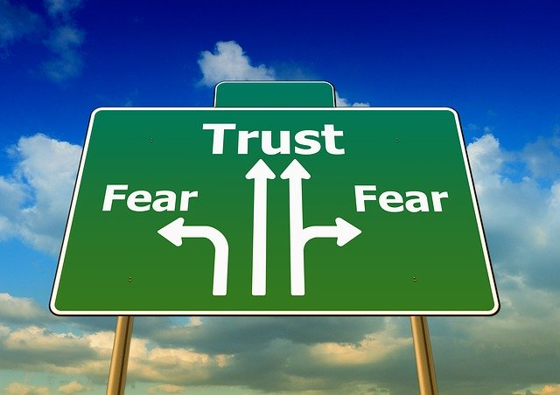
Building a Culture of Trust
When people trust their leaders, they’re willing to undertake change, even if it scares them.
Be Consistent… Avoid mixed messages which contradict the desired changes.
Ensure Quick Success—include early opportunities for success, no matter how small. Quick successes reassure the believers, convince the doubters, and confound the critics.
Own missteps and mistakes
Notes:
MD
When people trust their leaders, they’re willing to undertake change, even if it scares them. The good news is that you can build trust; the bad news is that it takes time to build it.
Share yourself honestly (but beware of using “honesty” as a cover/excuse for hostility). A lot of mistrust begins when people are unable to read you. While hiding your shortcomings may polish your image, it ultimately undermines people’s trust. Admitting an untrustworthy action is itself a trustworthy action.
Don’t be surprised if your trust-building project is viewed suspiciously. Asking people to let go of their old mistrust of managers puts them into a significant and dangerous-feeling transition. Their mistrust – justified or not—was a form of self-protection, and no one gives that up easily.
Leaders often find themselves fighting old battles (some possibly preceding that person’s tenure) when transition starts. Old grievances resurface, old scars start to ache, and old skeletons come tumbling out. On the positive side, every transition is an opportunity to heal the old wounds that have been undermining effectiveness and productivity. It is never too late to become an organization that manages its people well. For that reason, the old scar and the unresolved issue are great gifts. They represent opportunities for organizational enhancement.
Examples: Innovation Incubator – depts/agencies keep a lane open for success
That tool is key to developing the mental skills necessary to build trust and innovation!

Slide 15
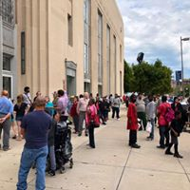
Step 3: Beginnings
Beginnings involve new understandings, new values, new attitudes, and—most of all—new identities
Starts can and should be carefully designed, like an object. A beginning can and should be nurtured, like a plant
Starts take place on a schedule as a result of decisions. Beginnings follow the timing of the mind and heart
Notes:
MD
Beginnings are psychological phenomena. They are marked by a release of new energy in a new direction—they are the expression of a new identity. They are much more than the practical and situational “new circumstances” that we might call starts.
Situations can change quickly; beginnings take place only when people are ready to make the emotional commitment to do things the new way and see themselves as new people
Examples: Preparing for Opening Day!
Bringing staff back 4 weeks ahead – some admin pushback (it’s their JOB to pushback – that’s part of what we need to have accountability and good rationale for our planning/work)
The new department, Fact and Fiction, decided to use a new tool together – do any of you use Basecamp? It is proving to be a great place to share detailed work plans and progress reports for learning equip, services & cross training. It’s something new that hadn’t existed for any of them before.
We’re at the beginning Right Now (example of goal setting / visualizing during the January MDSM meeting)

Slide 16
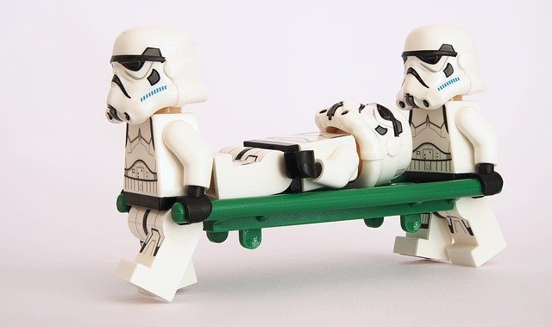
Consequences of poorly managed transition
A poorly or unmanaged transition leaves behind:
Survivors who have been wounded by the changes they have been through
Those who are grieving over all that they have lost in the change
Those whose loyalty and ethics have been so compromised by their experience that they turn hostile, self-centered, and subversive
Unmanaged transition fosters an environment of distrust, resentment and low morale, guaranteeing management difficulties and stagnation
Notes:
AH
Bridges shares a very effective German proverb: A great war leaves a country with three armies: an army of cripples, an army of mourners, and an army of thieves.
Similarly, a poorly or unmanaged transition leaves behind:
Survivors who have been wounded by the changes they have been through and are unable or unwilling to go forward
Those who are grieving over all that they have lost in the change and unable to appreciate or even understand any benefits that have been gained
Those whose loyalty and ethics have been so compromised by their experience that they turn hostile, self-centered, and subversive
Poorly or unmanaged transition creates an exhausted and demoralized staff who may consciously or unconsciously hinder positive outcomes and further growth. Either way, transition takes time. You get to decide where you spend it: helping people through the transition, or managing the chaos that remains after ignoring or skimping on the process that would have helped people get through.

Slide 17
And currently…..
Covid and quarantine
Bridges’ lessons continue

Slide 19
Change + Human Beings = Transition
Whatever currently exists is going to change.
It can be managed.
Notes:
MD
Bridges shares a lot of tools and goals for managing transitions. Don’t feel like you need to use all of them!
The tools you choose depend on where your culture is and what your culture needs.
In Toledo, the culture we’re building needs:
Commitment to regular communication
Evolving forms and documents with reliable info
Continual reassurance that “it’s going to be okay”and will be BETTER if you involve yourself in the meetings & discussions
Right now, each of you can commit to making one change. What will it be?
Go in to Q & A

Slide 20
Questions?
Meg.Delaney@toledolibrary.org
Amy.Hartman@toledolibrary.org
toledolibrary.org

